Slide 1

Hire Heroes USA
By
William Murwin &
Siddharth Dani

Slide 2
Problem Statement:
The development of Hire Heroes USA is directly proportional to the revenue generated by the Non-profit; hence our analysis is the deconstruction of the type of contributions received by Hire Heroes USA and understanding the behaviour of a donor to recommend further growth strategies.
Notes:
SID

Slide 3
Our Methodology
Preprocess
Understand
Consolidate
Clean
Transform
Convert CSV files
BASH Tools - grep - awk
- head
- sort
Filling gaps in Data Dictionary
Create ERD
Import SQLite DB
Removed Columns
Inconsistent:
Country Names
State Abv/Names
Time-zones
Missing: City/States/Zip-codes
Date w/ Year 2024
RecordType’s ‘Id’ truncate by 3 chars
Joined
as
one Table
Notes:
WILL
Email Address as a Country
2024 => 2014
When we discuss our data will further explain this last bullet

Slide 4
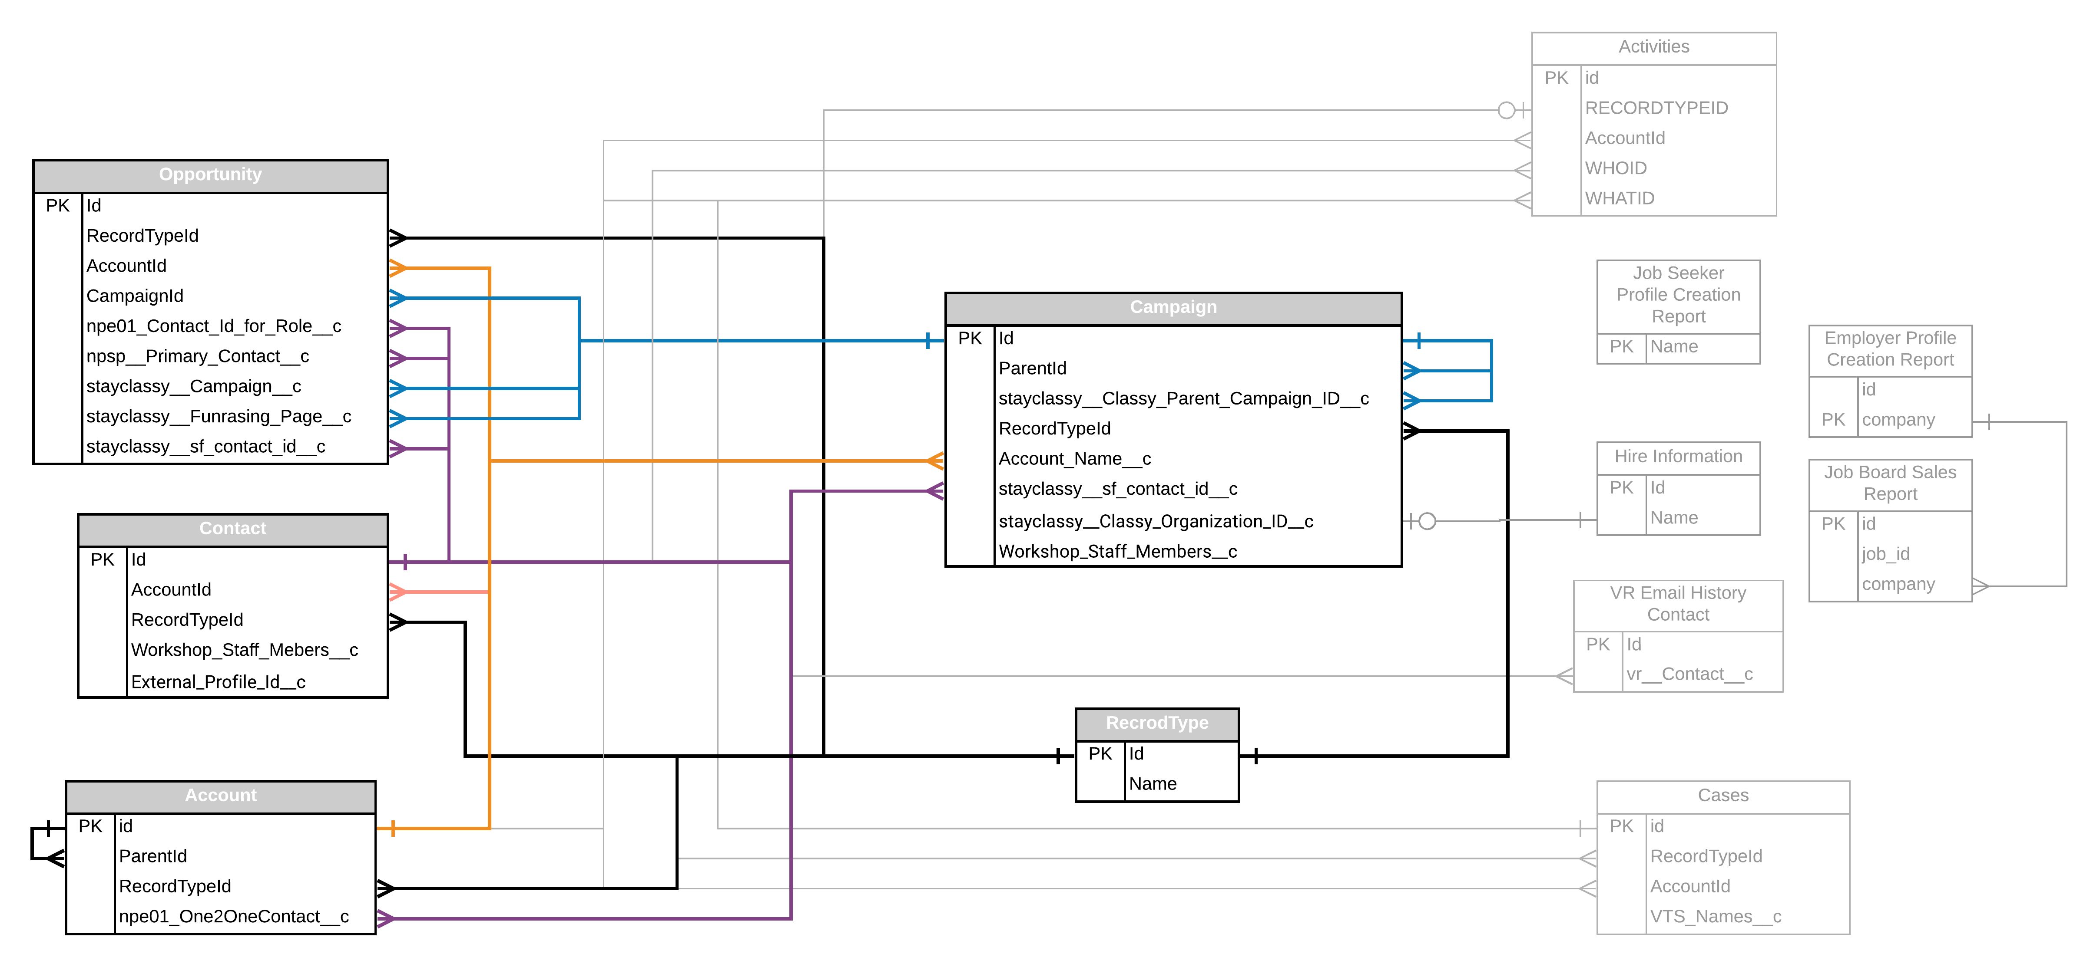
Hire Heroes Data (Relationships)
Notes:
WILL
11 Tables from their Salesforce Database and Job Board data collection
Many of the Table > 300 Columns
Largest Table - +450K rows
We Primarily worked with Subset of 5 Tables
Opportunity - ~130 Columns & 10K rows
Campaign -
Account -
RecordType - 12 Columns / 80 Rows
In Salesforce DB every instances has a RecordTypeId.

Slide 5
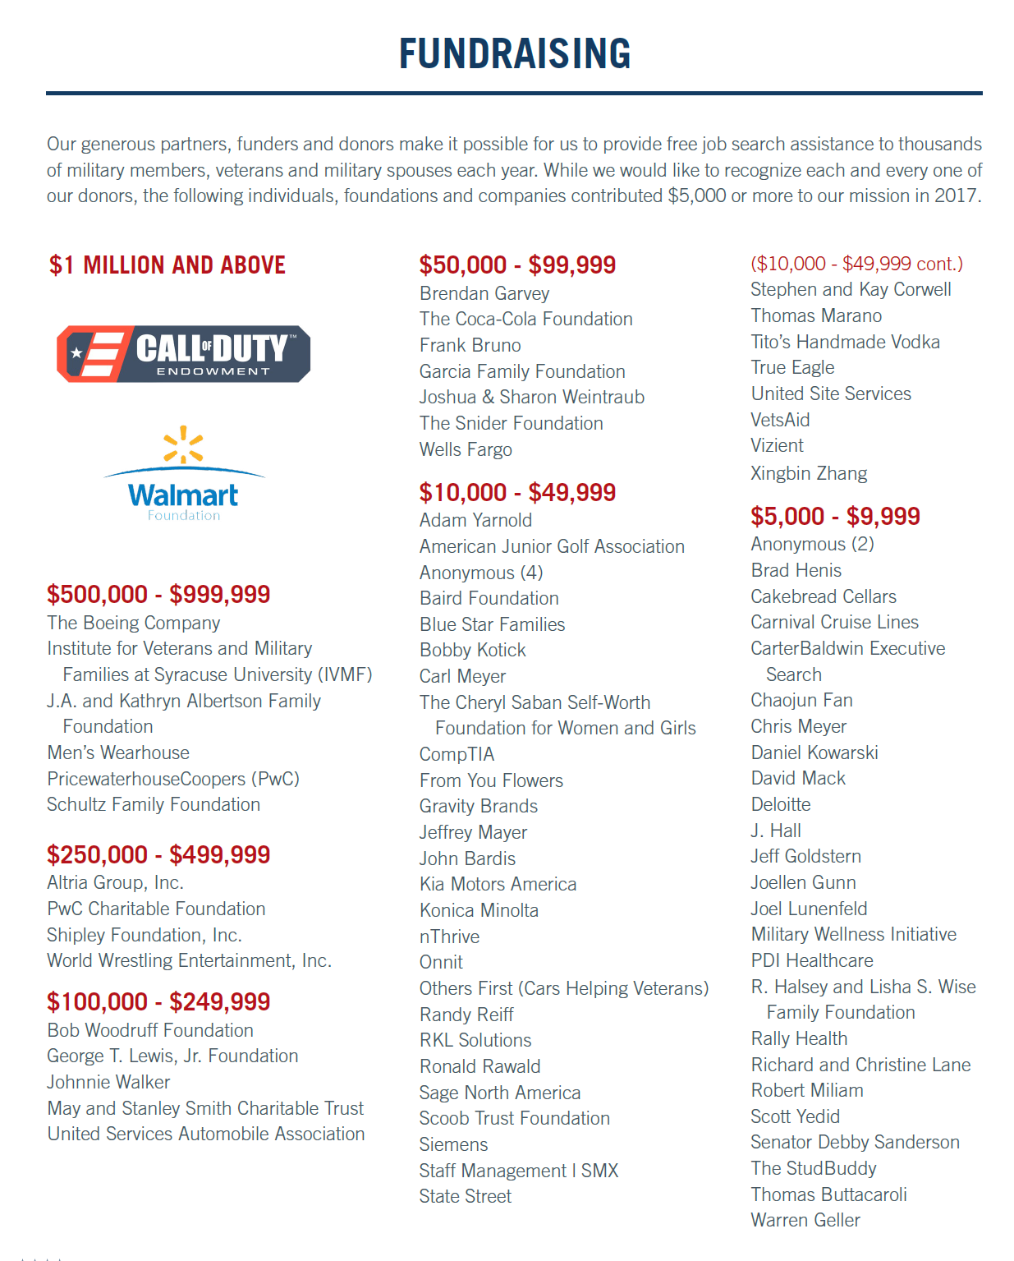
Created/Calc Variables
Donation Bins
Class No. | 1 | 2 | 3 | 4 | 5 | 6 | 7 | 8
Amount | <5K | >5K < 10K | >10K <50K | >50K <100K | >100K <250K | >250K <500K | >500K <1M | >1M
Donating Entity
Rank: | Contact ID | 2. Account’s Parent ID | 3. Account ID
‘New’ Donation Type
Prior Variables | Opportunity:: Type | Opportunity:: Dontation_Type | Opportunity:: Lead Source
{ “Contribution” , | “Grant”, | “In-Kind”, | “Fundraising” , | “Other” }
Notes:
WILL
Encoding/Prefix

Slide 6
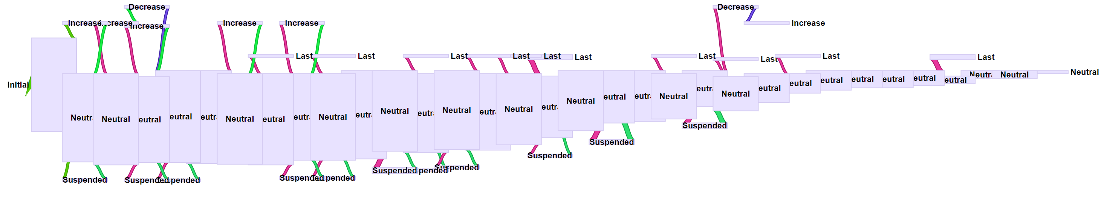

Individual Recurring Donor Behaviour

Slide 7
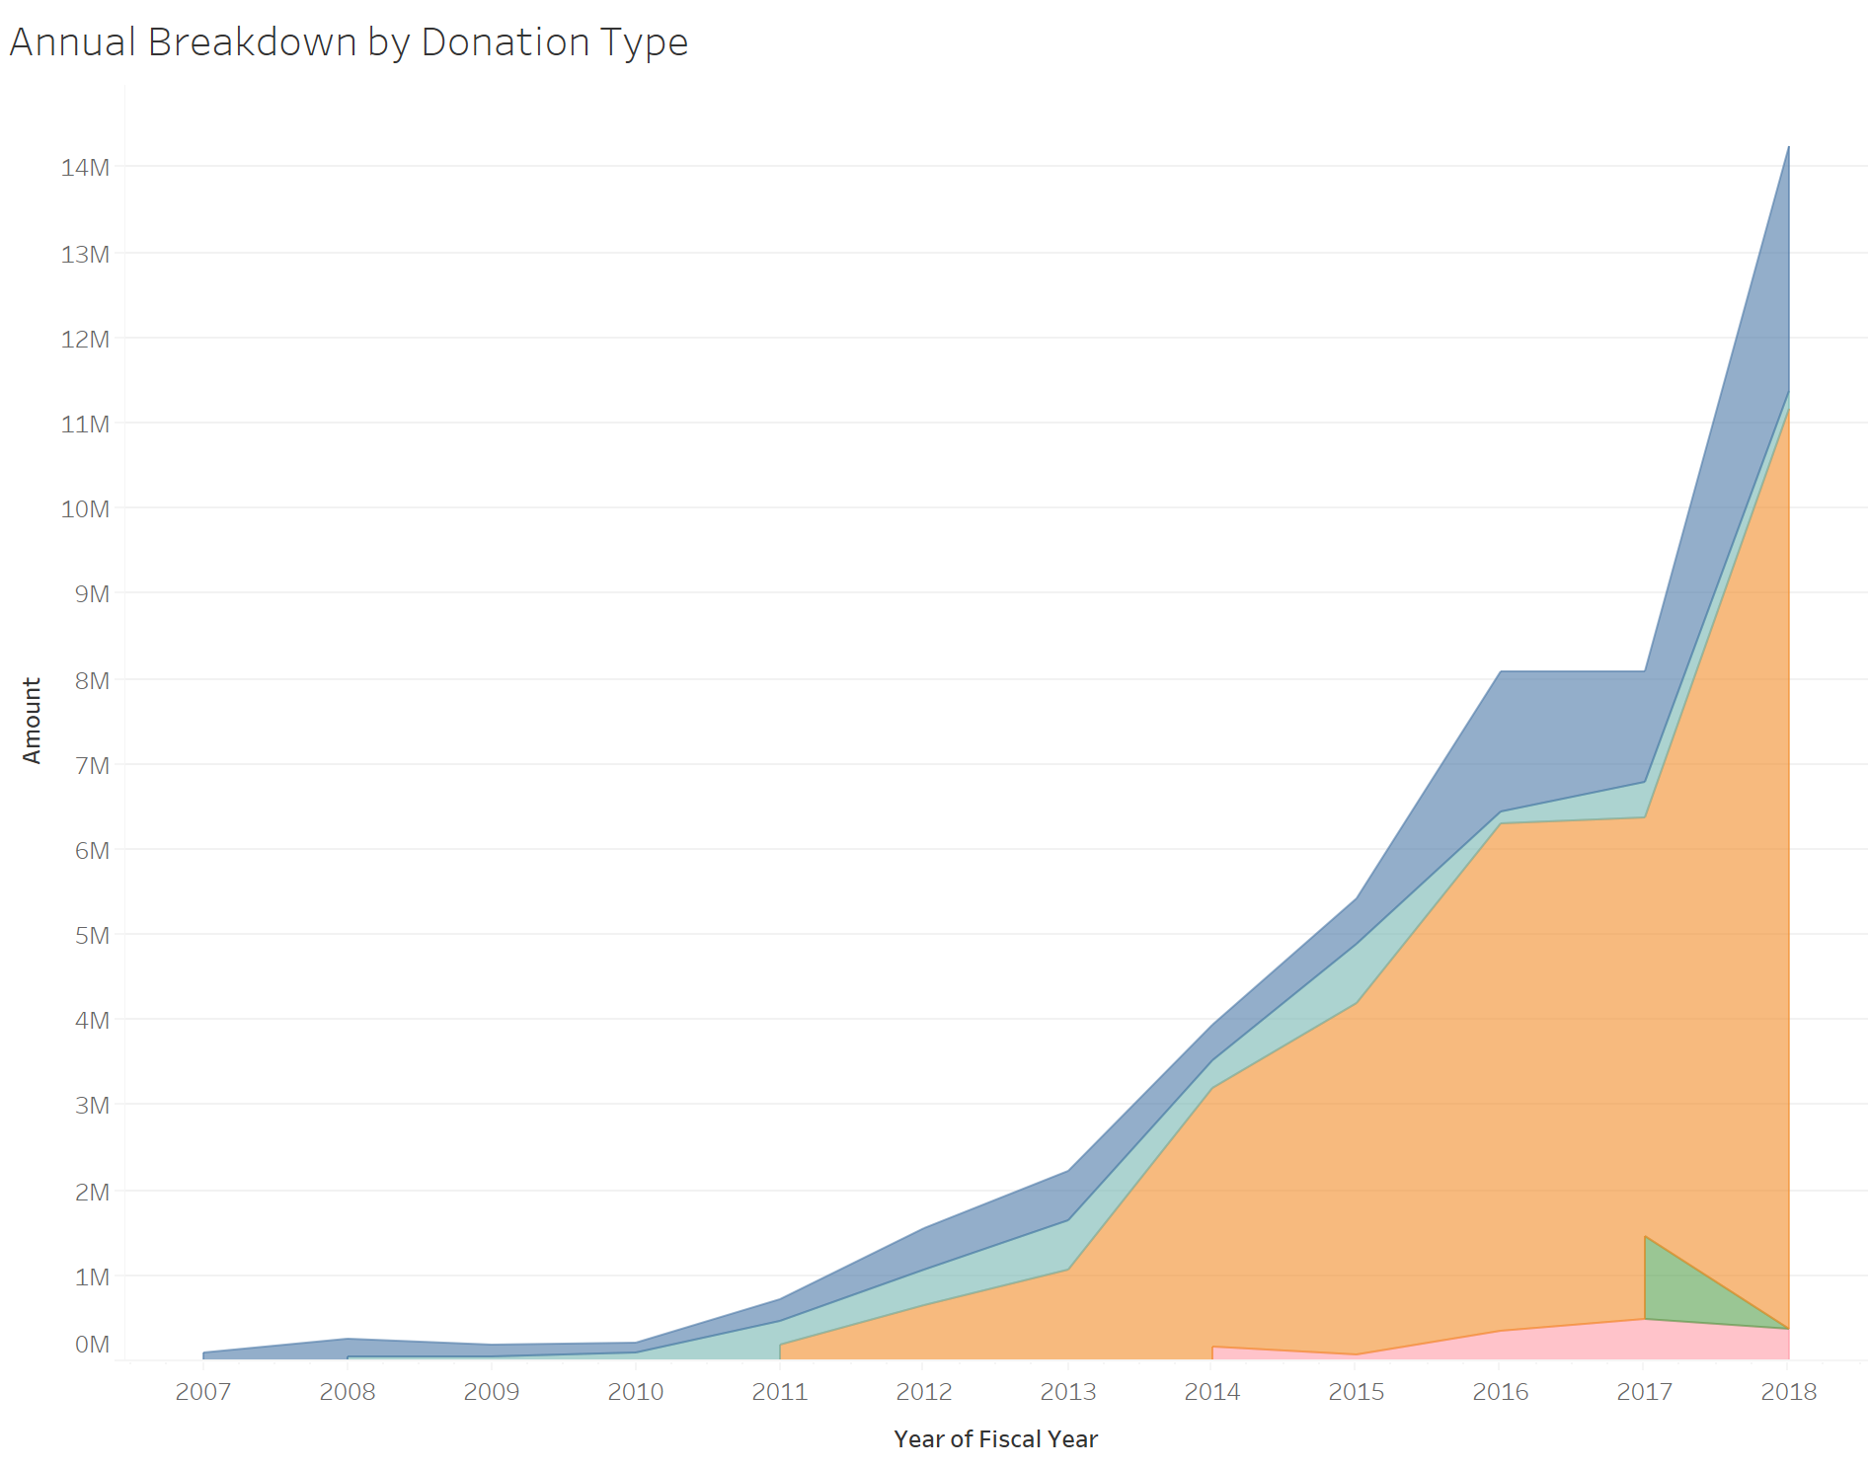
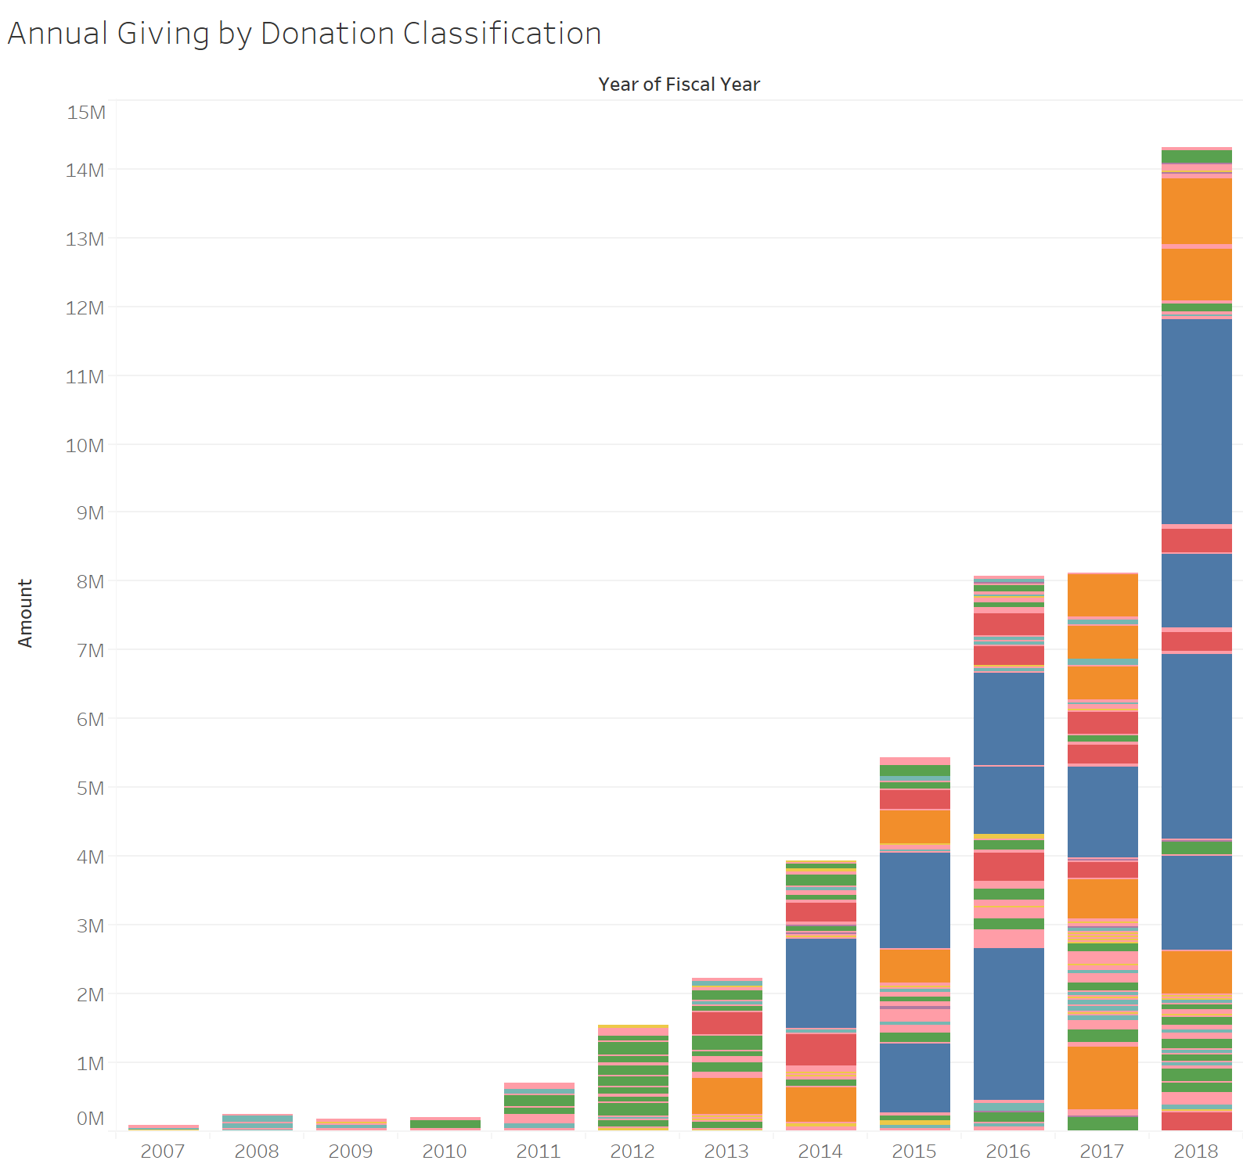
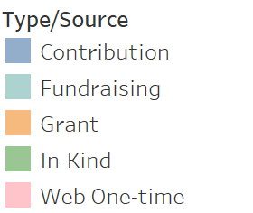
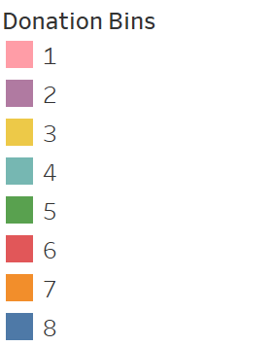
Chronological Donation Categorizations
Notes:
“Lead Source” => Opportunity Type => Donation Type

Slide 8
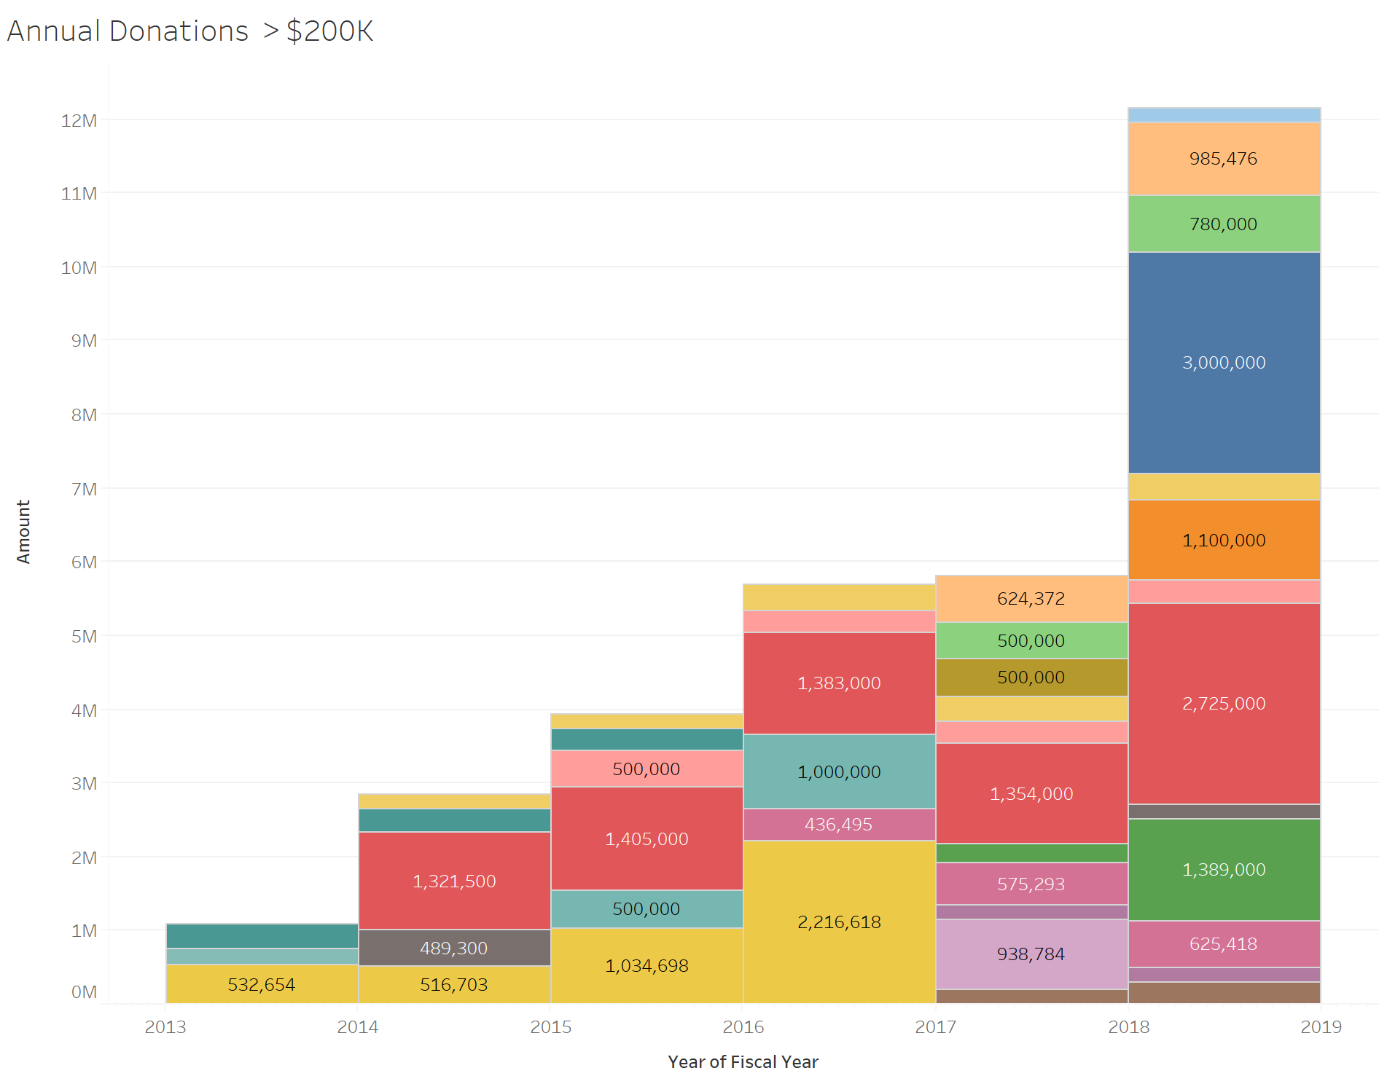
Gross Receipts >$200,000
Notes:
WILL

Slide 9
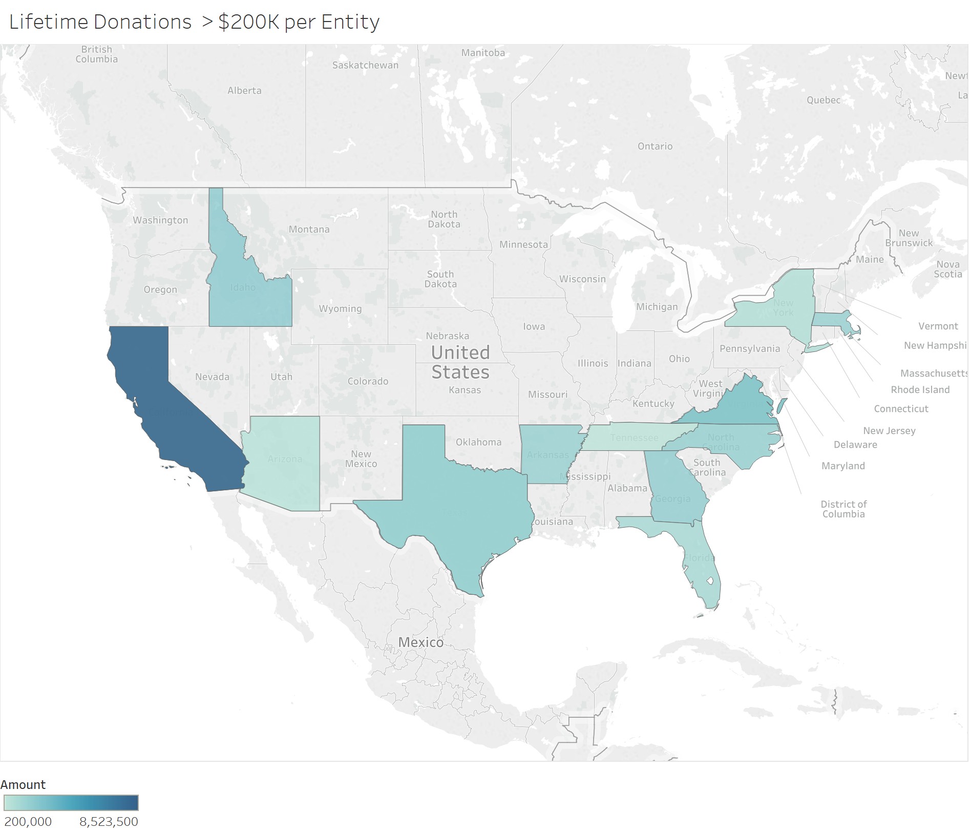
Summation of Top Donations By State
Notes:
WILL

Slide 10
Conclusions
Monthly Recurring donors (do increase annually). But recurring donation amount is vastly insignificant.
Recent 2x annual growth by GRANTS
Majority of annual donations come from few entities > $200,000.
Primarily Grants
Corporate Donations
Top Geographic Giving:
California
Florida
Texas
Virginia
Massachusetts
Notes:
SID

